Slide 1
Multi-Junction Traffic Controller Algorithm
Mihir Dhanakshirur

Slide 2
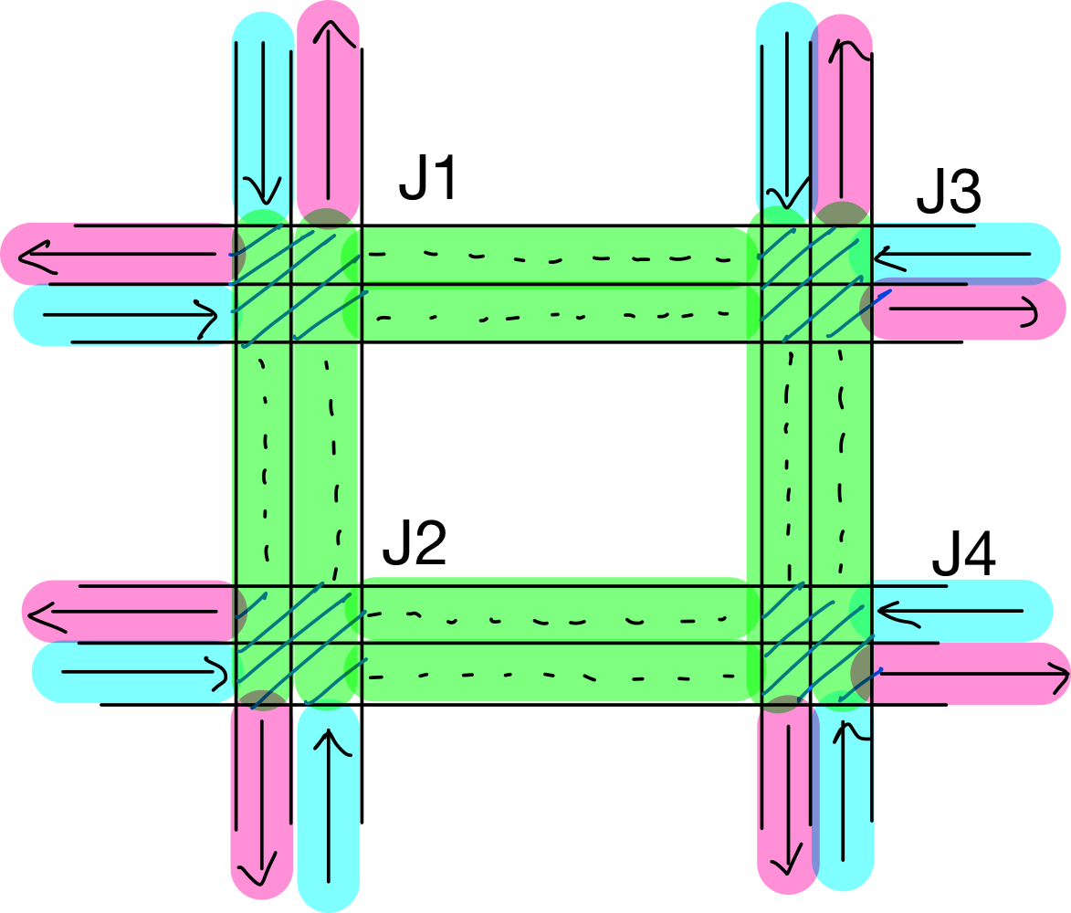
Overview
Designed to efficiently solve the multi-junction traffic controller problem.
Network consists of four junctions and vehicles enter and exit from the fringes.
Goal is to minimize both average queue length and waiting-time in the network.
Most algorithms tend to focus on one, while neglecting the other.
This algorithm aims to bridge the gap.

Slide 3
Algorithm

Slide 4
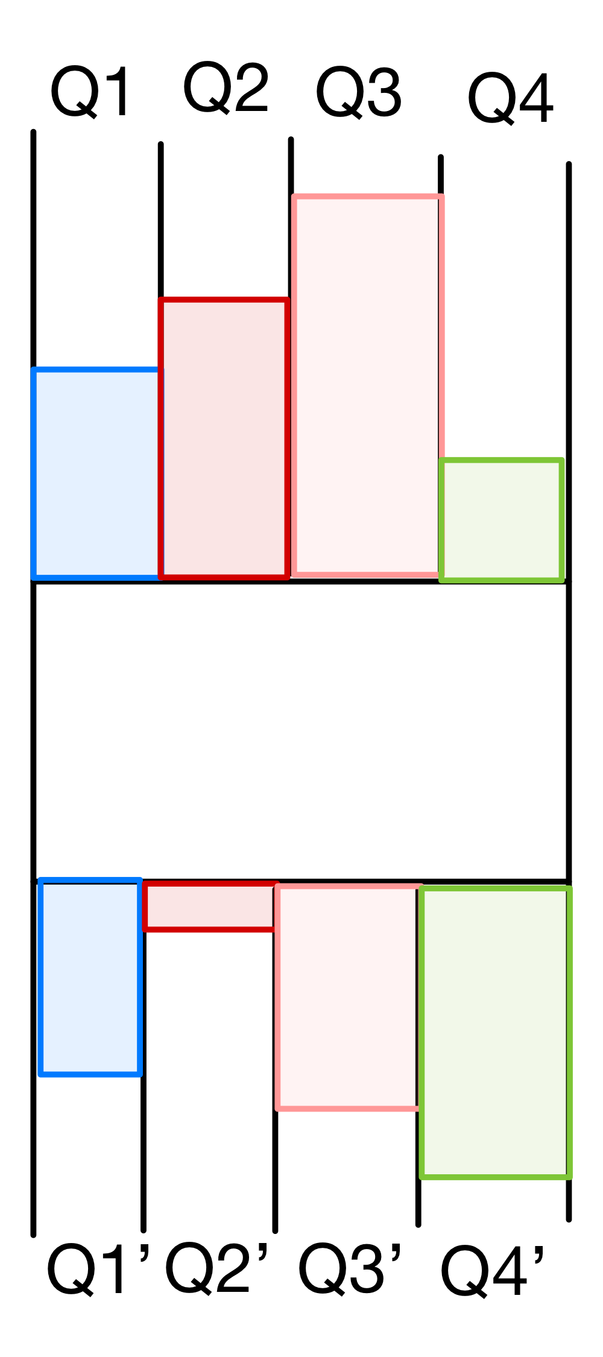
Backpressure Algorithm
Commonly used in communication networks and is proven to be throughput optimal.
Simply put, backpressure scheme tries to direct packet flow along the queue with
Maximum existing queued packets
Minimum queued packets upstream
The controller calculates Q_{i} – Q_{i}’ for all i, and chooses
to “activate” or “enable” the queue with maximum
difference ,i.e, backpressure.

Slide 5
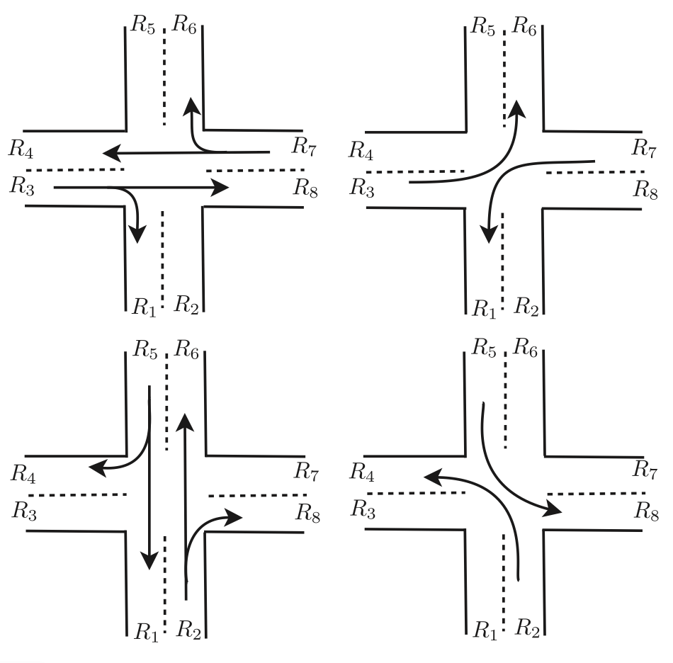
Backpressure Algorithm
Similarities between communication networks and traffic networks
Packets ⬄ Vehicles
Nodes ⬄ Junctions
Edges ⬄ Roads
Queues ⬄ Lanes
The backpressure algorithm, after tuning it for traffic networks, can be easily used.
In traffic networks the concept of phases arises, and the controller selects appropriate phases after computing all the backpressures.

Slide 6
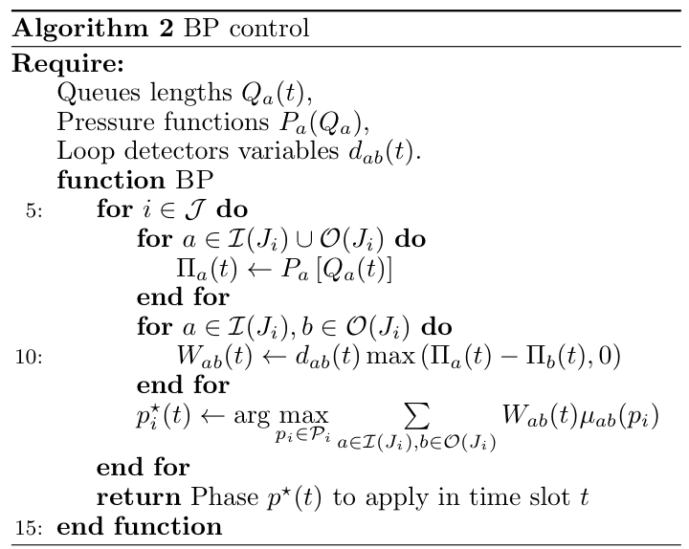
Sketch of BP Algorithm

Slide 7
Advantages of using BP Algorithm
Since the algorithm is throughput optimal, communication networks are stable up to arrival rates of .8 vehicles/sec. Similar stability has been seen in traffic networks.
Algorithm is not burdened by dimensionality problems as seen in the case of Q-learning and function approximation algorithms belonging to the reinforcement learning paradigm.
Algorithms can easily be implemented in a distributed fashion without increasing complexity as controller requires only next-hop junction information.

Slide 8
Motivation for Waiting-Time Component
BP algo is designed to handle large volumes of traffic, commonly seen in communication networks.
Exceptional performance is seen when arrival rates are at the boundary of the capacity region.
Problems arise for low volumes of traffic or when vehicles are not equally distributed between the edges entering the junction.
BP algo will ensure that queue length are kept at a minimum and vehicles in large queues are almost always in motion, but vehicles part of smaller queues end up waiting for arbitrarily large amounts of time.
In general, the BP algo fails to produce good results in terms of the overall waiting-time in the network.

Slide 9
Waiting-Time Component
To make sure that vehicles belonging to smaller queues are not stuck for extended periods, a quantity called “thresh” is measured at each junction(simultaneously with queue length at each lane).
As soon as the “time-since-last-green” for a particular lane exceeds the “thresh” value, the controller immediately activates the corresponding lane.
For low-volume traffic it makes more sense to have a lower “thresh” value, while for high volume traffic, a greater “thresh” value is required; priority should be given to managing queue lengths in this case.
Note that choosing between “thresh” value and backpressure measurements is a tradeoff. Sometimes a lower ”thresh” value may come at the cost of allowing larger queue lengths.

Slide 10
Time-loss component
This is where Neural Networks come to play. They help in choosing an optimal thresh value which minimizes the overall time-loss.
Time-loss is the performance metric by which the efficiency of the network is evaluated.
”thresh” values are varied from 10 – 100 seconds in intervals of 10. The corresponding time-loss of the network in the simulation time is measured.
Linear regression is performed with “thresh” values as inputs and time-loss as the desired-output.
A suitable ”thresh” value which minimizes the time-loss in the networks is then chosen and used going forward.

Slide 11
Neural Network Features
The regression is performed using the MLP regressor available as a part of sklearn.
The MLP consists of 3 hidden layers each consisting of 25 neurons.
Using the logistic/sigmoid activation function and lbfgs (Limited-memory Broyden-Flethcer-Goldfarb-Shanno) solver.
Setting the maximum iteration to 5000, we achieve a smooth predicted function, making it easy to compute the minima by a simple graphical observation.

Slide 12
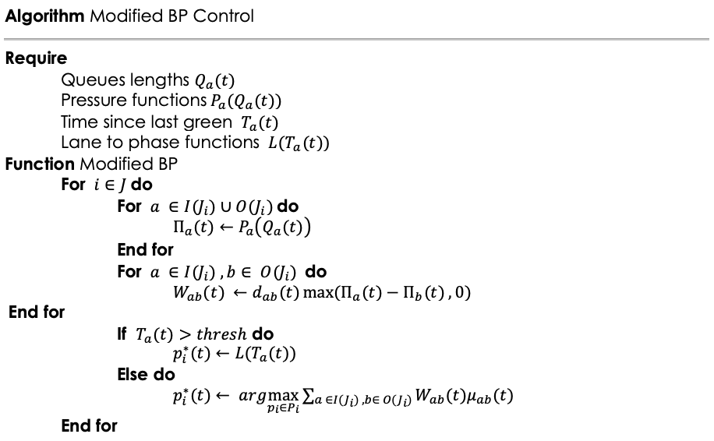
Modified BP Algorithms

Slide 13
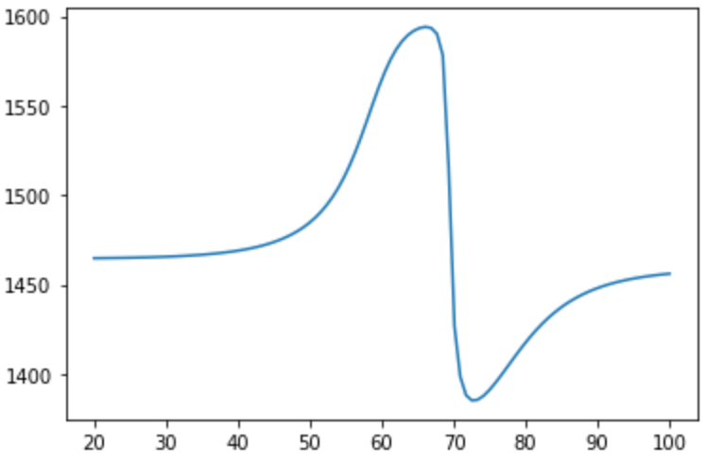
Predicted Values by Neural Network
Curve predicted by MLP Regressor
Time-Loss (seconds)
Values of “thresh” (seconds)

Slide 14
Simulation

Slide 15
Simulation
The simulation was run on SUMO, a GUI used to model real-world traffic networks.
To generate the data set, a range of “thresh” values were taken, and the corresponding time-loss (in seconds) was taken as the output.
This data set was fed to a neural network and the optimum “thresh” value was graphically observed.
The obtained “thresh” value was fed to the network and measures such as time-loss, total queue length, and waiting time were measured.

Slide 16
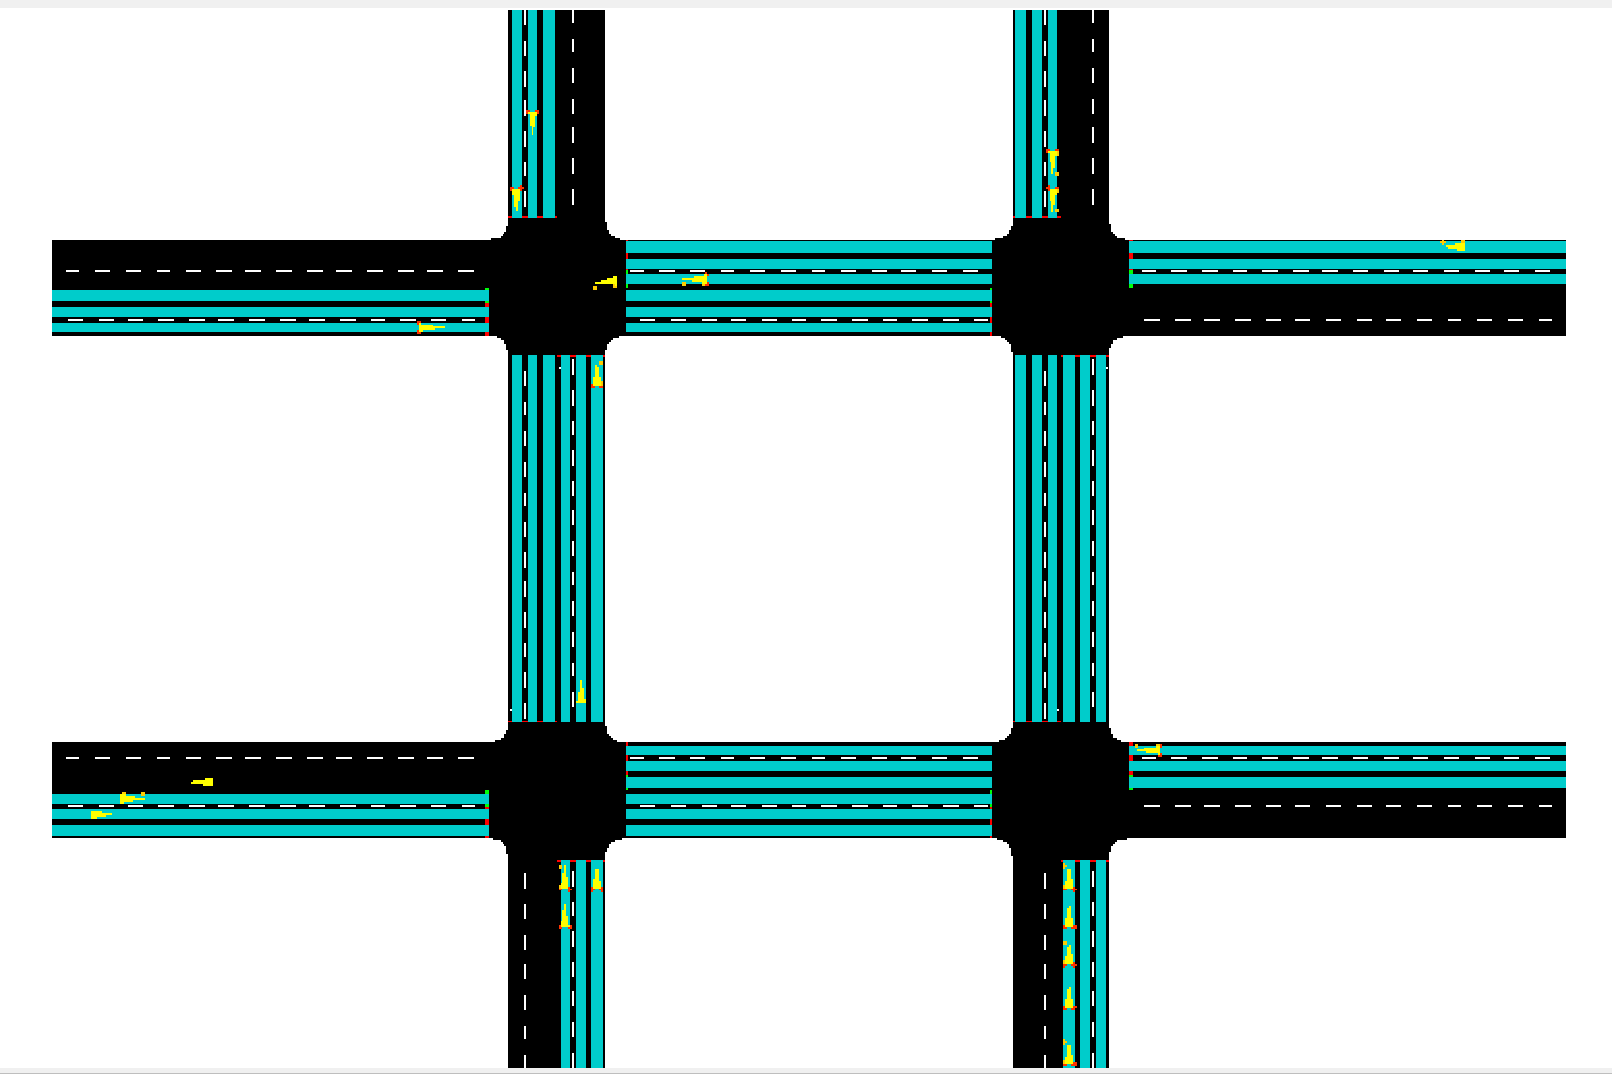
Demonstration (with static)

Slide 17
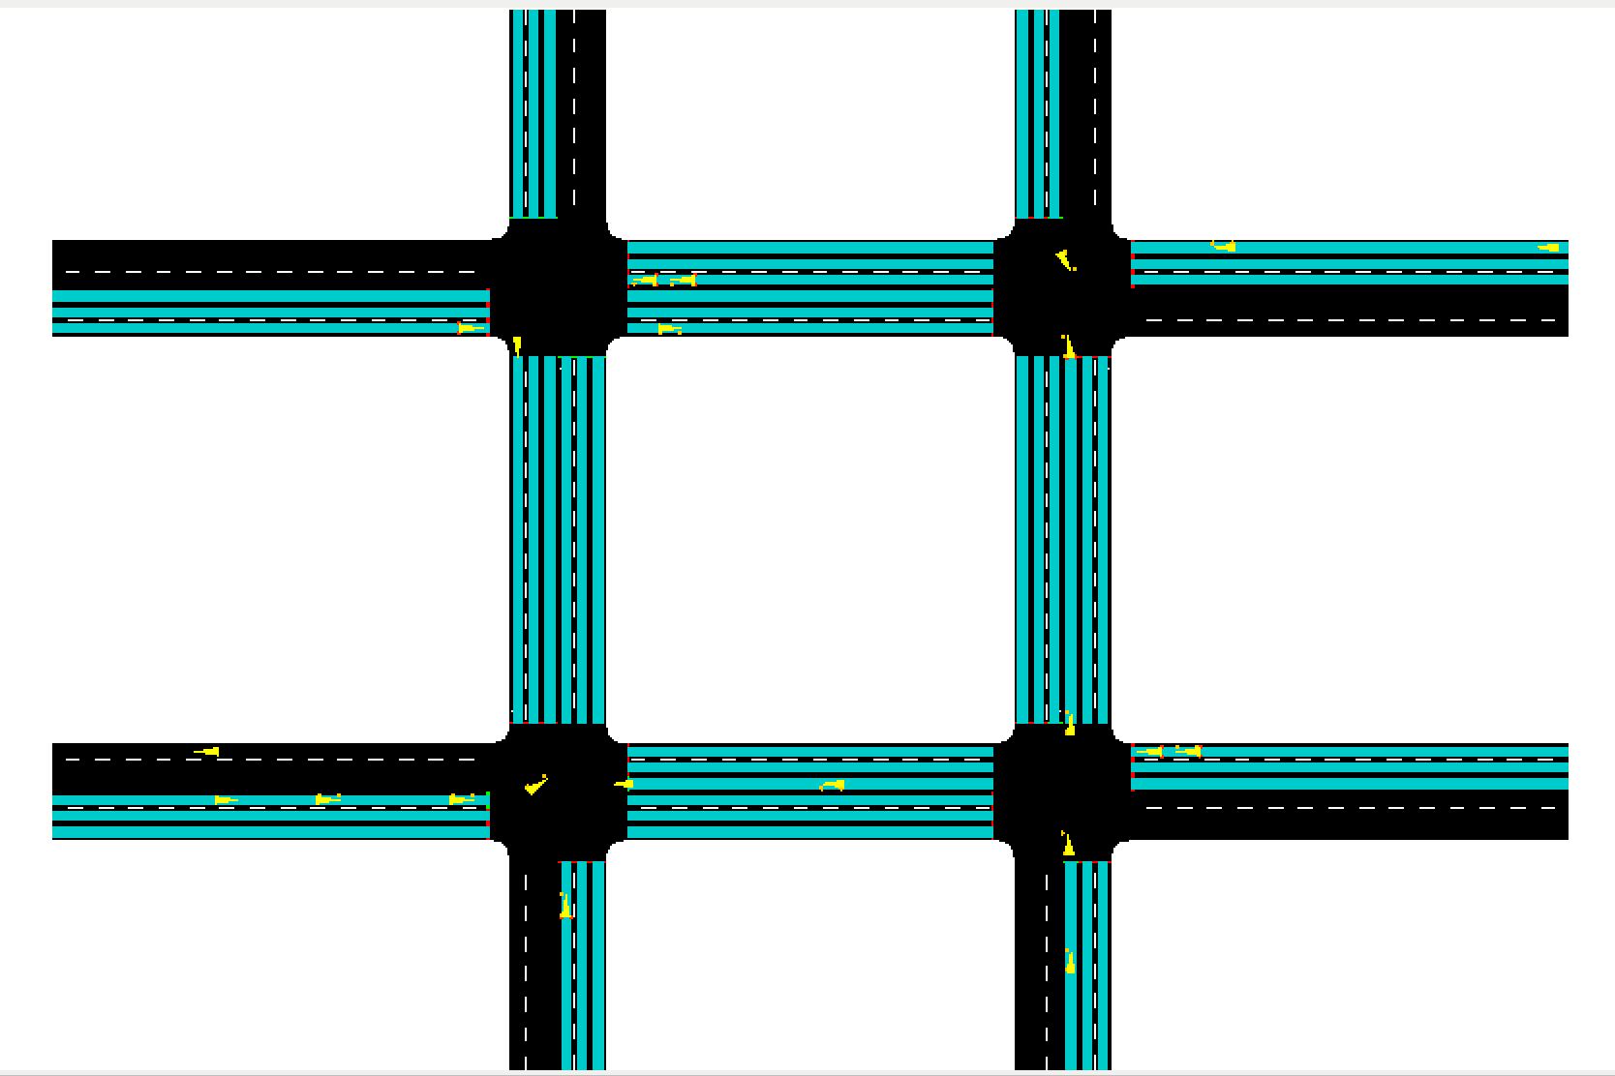
Demonstration (with backpressure)

Slide 18
Results

Slide 19
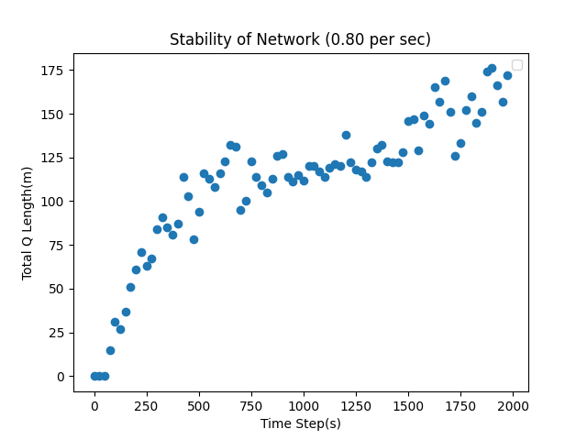
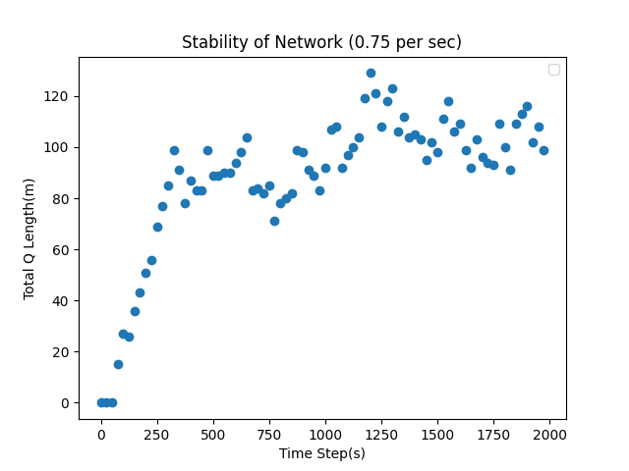
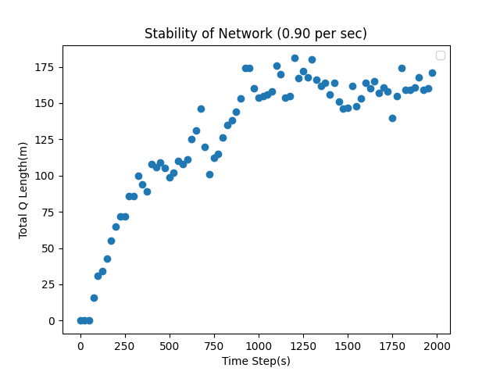
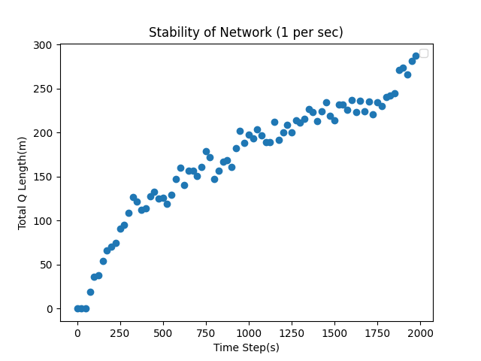
Results: Stability

Slide 20
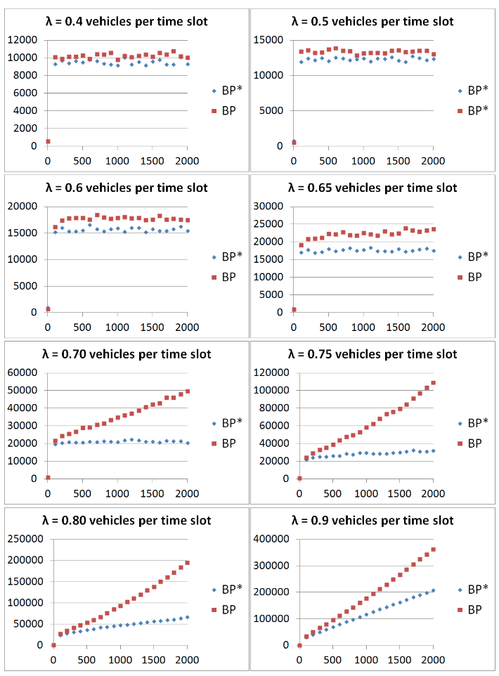
Results: Stability

Slide 21
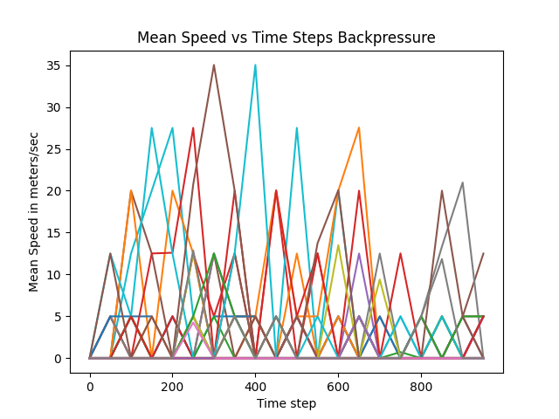
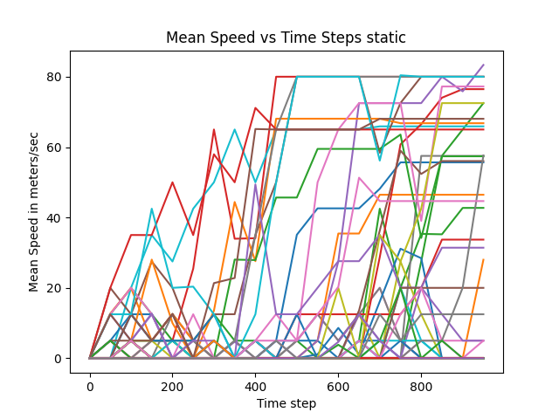
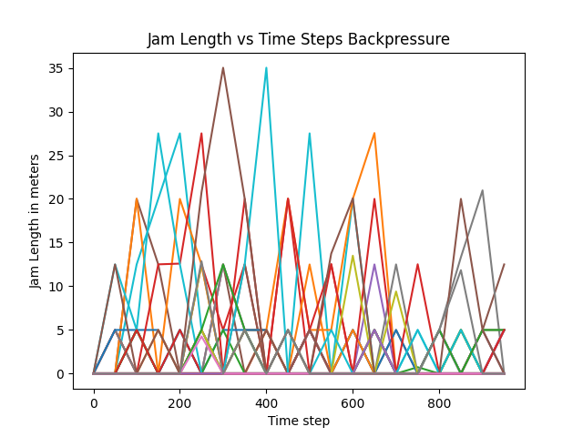
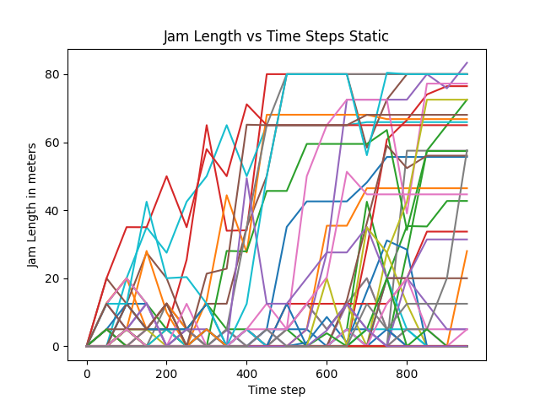
Comparison: Mean Speed and Jam Length

Slide 22
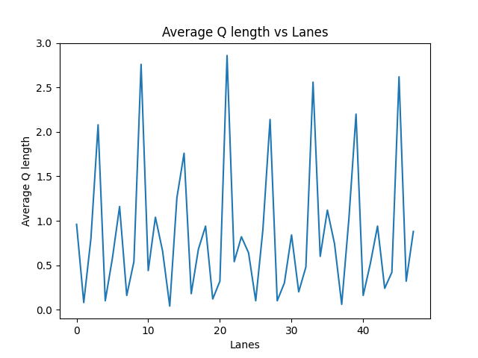
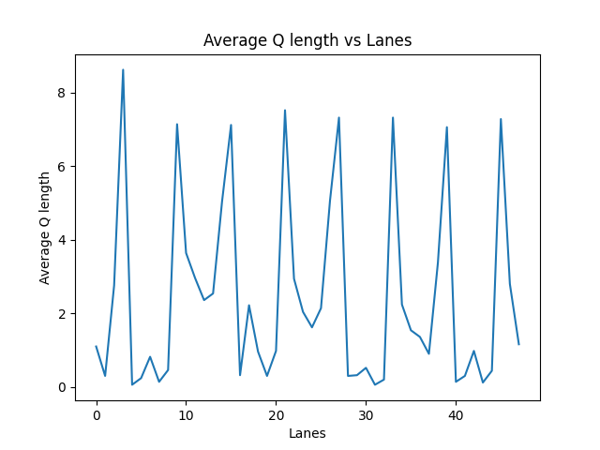
Comparison: Queue Lengths
Backpressure
Static

Slide 23
Future Work
Expansion to larger networks is a massive unexplored area. Sub-networks of around 4 junctions can be compartmentalized and treated as one unit.
Boundary cases of extremely high volume along certain lanes and minimal volume along others could also be explored.
The algorithm is time invariant, so fluctuations in traffic levels means that the algorithm needs to be repeatedly run. This delay might hinder initial flow of traffic.

Slide 24
Acknowledgements
Professor Shayan Garani and the TAs part of the NNLS course for giving me the opportunity to present the project.
Professor Chandramani Singh for his role in guiding me and assisting throughout the project.

Slide 25
Thank you!
References to be mentioned in project report

